Slide 1
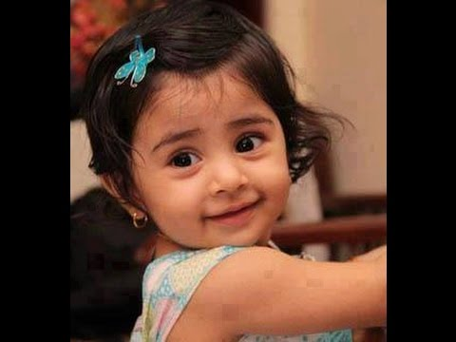
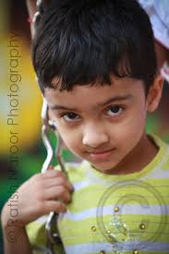
CHILD
MARRIAGE

Slide 2
Child marriage.
Mostly in INDIA……..
Child marriage in India, according to the Indian law, is a marriage where either the woman is below age 18 or the man is below age 21. Most child marriages involve underage women,

Slide 3

Many news were there for it
in Rajasthan Child marriages halved in 10 years
Child marriage in India today
Fund boost to make Rajasthan a child marriage free state

Slide 4
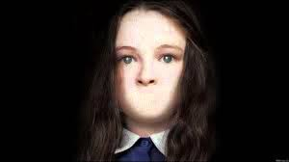
But everybody is
SILENT……

Slide 5
Advantages and disadvantages
advantages
There are actually no advantages of child marriage .
there is mainly health issue with girls.
the girl and the boy are not properly educated and lose their childhood very soon…
disadvantages

Slide 6
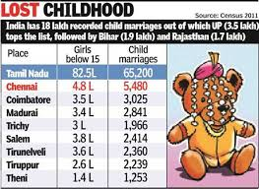
The status

Slide 7
Children are losing their childhood in a very small age . The child marriage is mostly done in RAJISTHAN in INDIA ! Everyone talks about it , says about it, but never takes action on it !?
BUT
Why ???

Slide 8

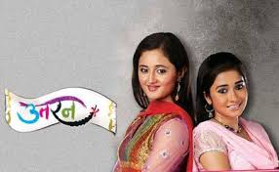
Many shows were there for this
Social issue
Balika vadhu utran

Slide 9
BUT
NOTHING
HAPPENED
Still in INDIA child marriages are being done . Campaigns are being done. Nothing Works………….

Slide 10

Change the world
Change the old thinking
Change old traditions
STOP child marriage

Slide 11
one changes his or her mind , that one
Can change the whole world

Slide 13

And save childhood! And children

